Slide 1


Nov, 4th. 2024
E-COMERCE SALES ANALYSIS
Data-Driven Insights and Recommendations
By: Fatma Mohamed Abdel Fattah

Slide 2
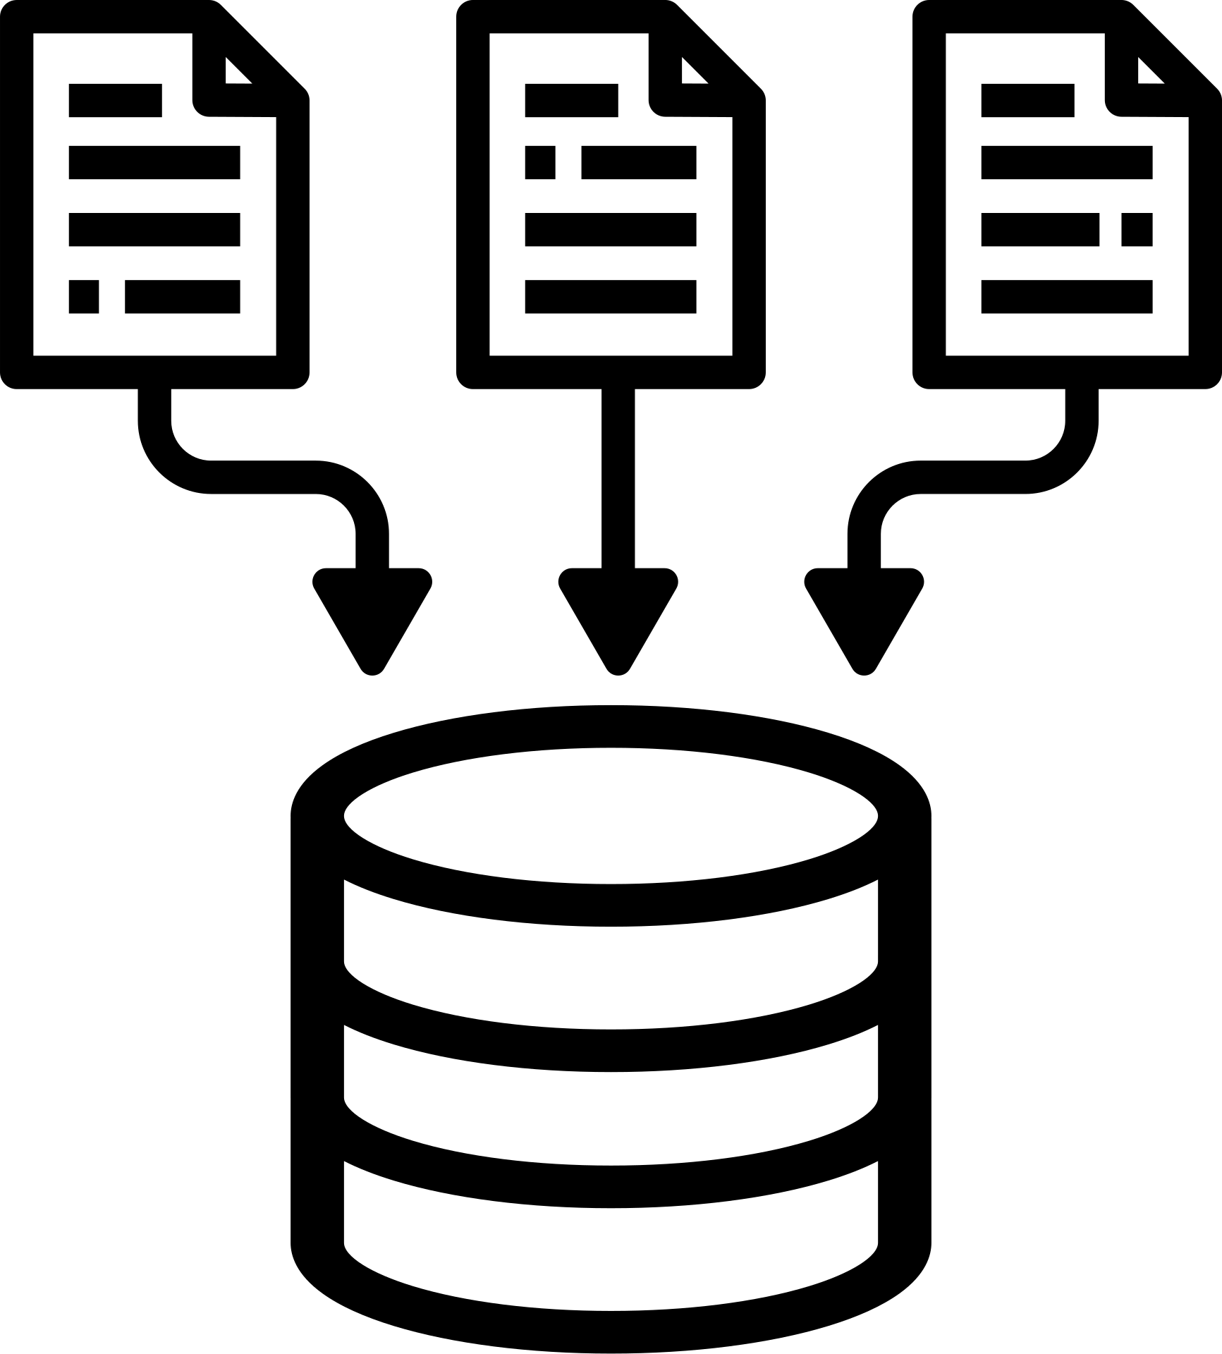
DATA PROFILE
This is a Brazilian ecommerce public dataset of orders made at Olist Store. The dataset has information of 100k orders from 2016 to 2018 made at multiple marketplaces in Brazil.
DATA TABLES
Customers Dataset: Customer details and location; unique and repeat customer IDs.
Sellers Dataset: Seller info and location.
Orders Dataset: Core dataset; links all other tables, with order status, timestamps, and delivery dates.
Order Items Dataset: Item details within orders; links products, sellers, and pricing.
Payments Dataset: Payment methods, values, and installment details.
Products Dataset: Product names and unique IDs.

Slide 3

DATA PROFILE
This is a Brazilian ecommerce public dataset of orders made at Olist Store. The dataset has information of 100k orders from 2016 to 2018 made at multiple marketplaces in Brazil.
KEY COLUMNS
customer_id, order_id, seller_id, product_id: Link tables for customer, order, product, and seller details.
price, freight_value: Cost and shipping for each item.
order_status, timestamps: Order lifecycle and timing info.

Slide 4

DATA IMPORTING AND TRANSFORMING
DATA IMPORT
Tool: Power BI
File Type: Microsoft Excel Comma Separated Values File (.csv)
DATA TRANSFORMATION
Handled some column mis-identification, using First row as header function
Dropped irrelevant columns i.e. seller_zip_code and customer_zip_code

Slide 5
DATA CLEANING
Merged the Products_dataset with the Product_category_translation dataset on the product_id. Then, dropped the Brazilian category_name; reducing redundancy
Dropped the geolocation dataset; since it is out of my scope of analysis
Created an “OrderDate” column to ensure Date consistency of the orders
Created a Summarization table for Frequent customers with more than 1 visit to my Olist Store

Slide 6
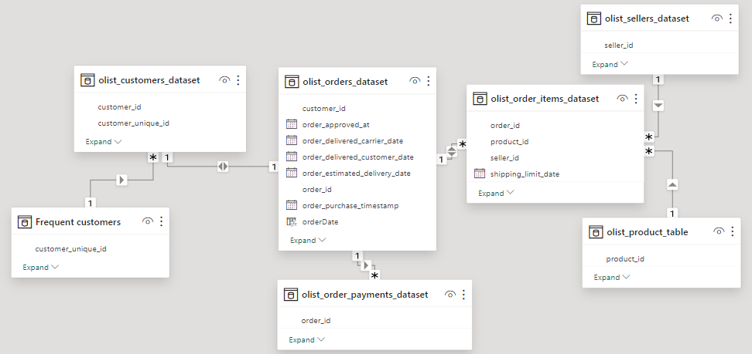
DATA MODELLING (ERD)

Slide 7
DATA MODELLING (ERD)
Structure: SnowFlake schema with the “Orders” table as the Fact table
Connecting the customers, payments, and order items as the Dimensional Tables
The “order items” table has two sub-dimensional tables; sellers and products
customers has one sub-dimensional table; Frequent Customers

Slide 8

BUSINESS QUESTIONS
What are the total sales?
What are the sales metrics for different time periods? (YTD, QTD, MTD)
Which states and cities have the highest sales?
How do sales vary by date?
What percentage of orders were delivered successfully? And how many of them were delivered late?
How many product categories are in my store and their average price?

Slide 9
BUSINESS QUESTIONS
How many customers visited my E-Store? And How many of them were Loyal customers who returned?
How do my customers prefer to pay?
Which product categories are the best sellers?
What are the sales figures for each product category?
How many sellers are there, and what are their sales figures?
What is the average delivery duration compared to the estimated delivery duration?

Slide 10
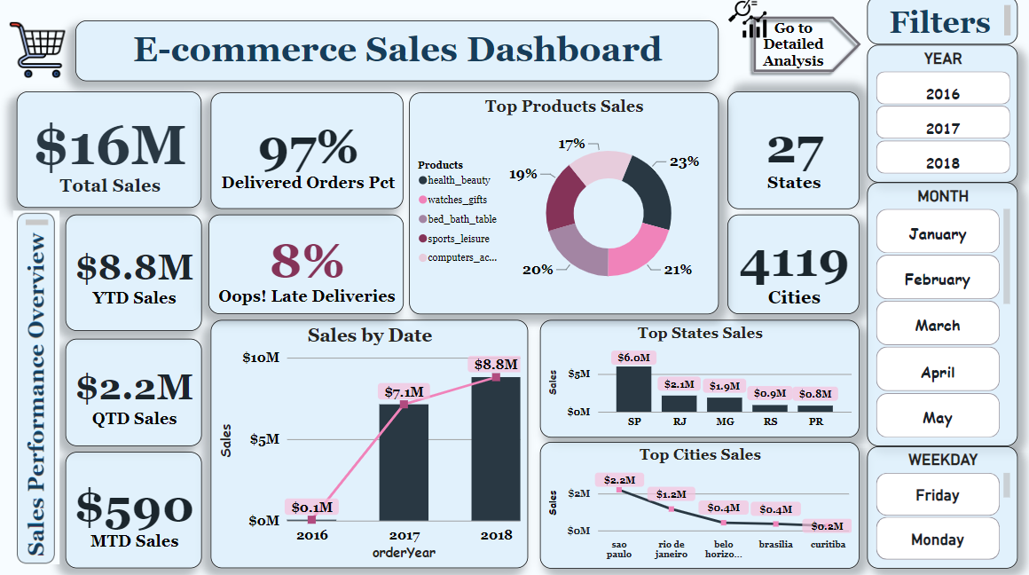

Slide 11
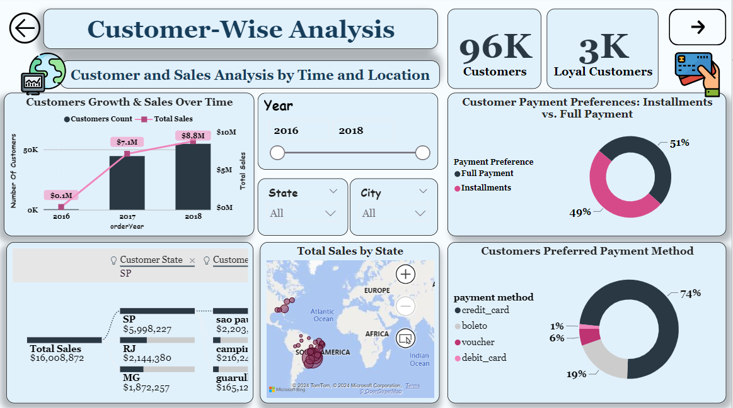

Slide 12
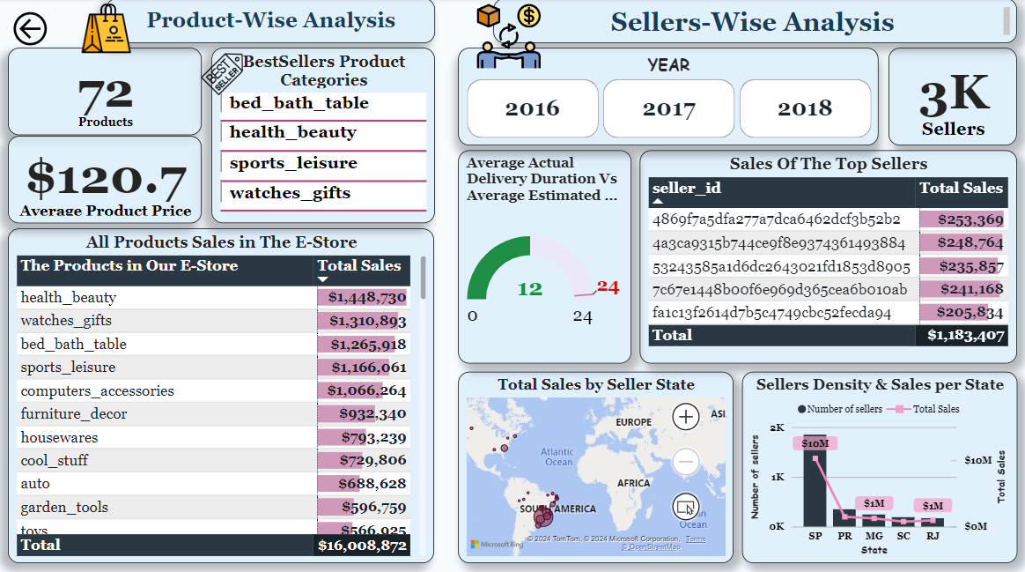

Slide 13

OBSERVED INSIGHTS
Total Sales: $16M revenue.
Sales by Year: Grows from 2016 to 2018.
Successful Delivery: 97% rate.
Late Deliveries: 8% of orders were delivered later than estimated.
Delivery Duration: The average estimated duration was 24 days but our E-Store could achieve an average of only 12 days
Sales by Region
Top States: SP, RJ, MG, RS, PR
Top Cities: Sao Paulo, Rio de Janeiro, Belo Horizonte, Brasilia, Curitiba

Slide 14

RECOMMENDATIONS
With 8% of orders delivered late, focus on optimizing logistics and supply chain processes to reduce delays.
Consider partnering with more reliable carriers or implementing better tracking systems.
States like SP, and RJ and cities like Sao Paulo and Rio de Janeiro, show strong sales.
Consider opening more distribution centers or local stores in these areas to capitalize on the demand.

Slide 15

CONCLUSION
In summary, our e-commerce platform is thriving with impressive sales figures and high on-time delivery rates. By focusing on our top-performing product categories and expanding in high-demand regions, we can continue to drive growth and enhance customer satisfaction.

